Slide 1
Designing Rail Station in OpenGl 3.3
Presented By
Abrar Hasan
1807024
Department of Computer Science & Engineering
Khulna University of Engineering & Technology
Khulna -9203, Bangladesh.

Slide 2
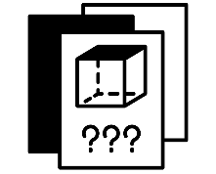
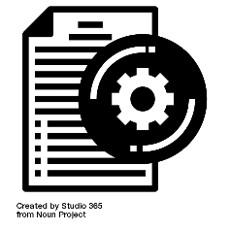



Outlines
01
02
03
04
Functional
Description
Detailed
Visualization
Introduction
CONCLUSION

Slide 3
Outlines
01
Introduction

Slide 4

Introduction
What are the basic objects of the Project
Half Circle
Wheel
Cube
Sphere
Full Circle
Cylinder
Fig 1.1: Basic shapes of project

Slide 5
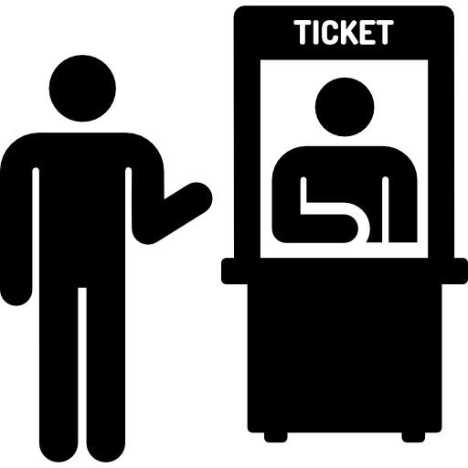


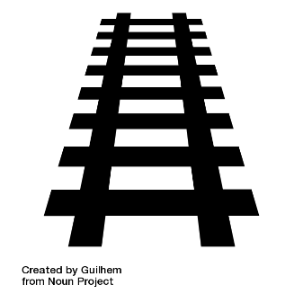
Introduction(contd.)
The Component of a Rail Station
Train
Ticket Counter
Rail Track
Welcome Screen
Fig 1.2: General Component of Rail Station

Slide 6
Outlines
02
Functional
Description

Slide 7
Functional Description
W : MOVE FRONT
E : MOVE UP
S : MOVE BACK
F : MOVE DOWN
A : MOVE LEFT
D : MOVE RIGHT

Slide 8
Functional Description(contd.)
K : ROLL LEFT
Y : YAW RIGHT
J : ROLL RIGHT
T : YAW LEFT
I : PITCH UP
U : PITCH DOWN

Slide 9



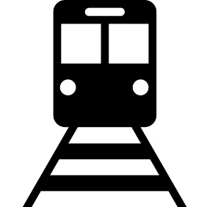
Functional Description(contd.)
P : DOOR OPEN
H : TURN ON FAN
O : DOOR CLOSE
L : MOVE TRAIN

Slide 10
Outlines
03
Detailed
Visualization

Slide 11
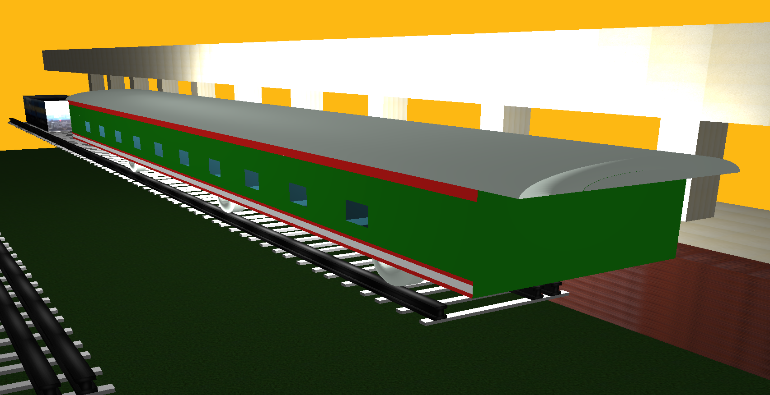
Detailed Visualization

Slide 12
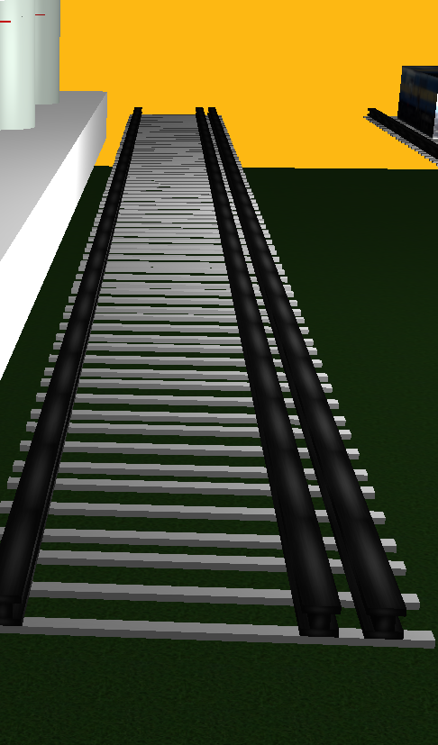
Detailed Visualization(contd)

Slide 13
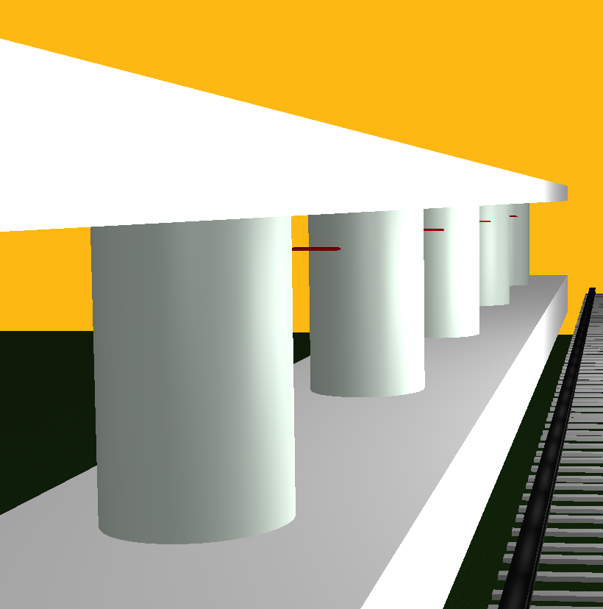
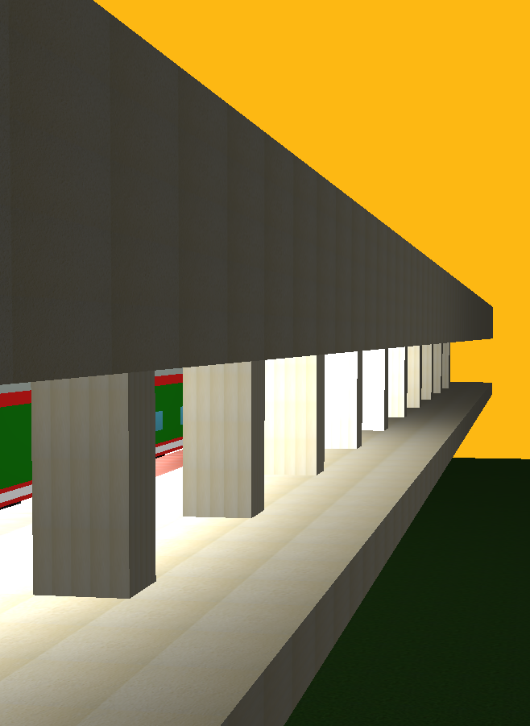
Detailed Visualization(contd.)

Slide 14
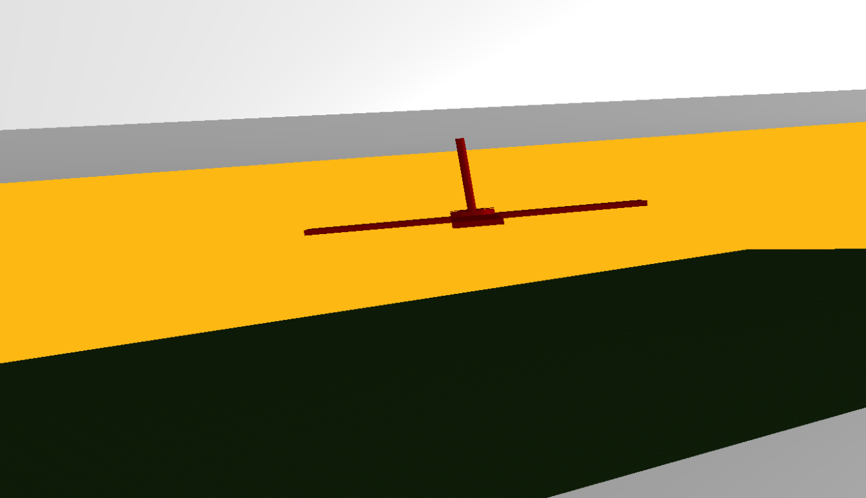
Detailed Visualization(contd.)

Slide 15
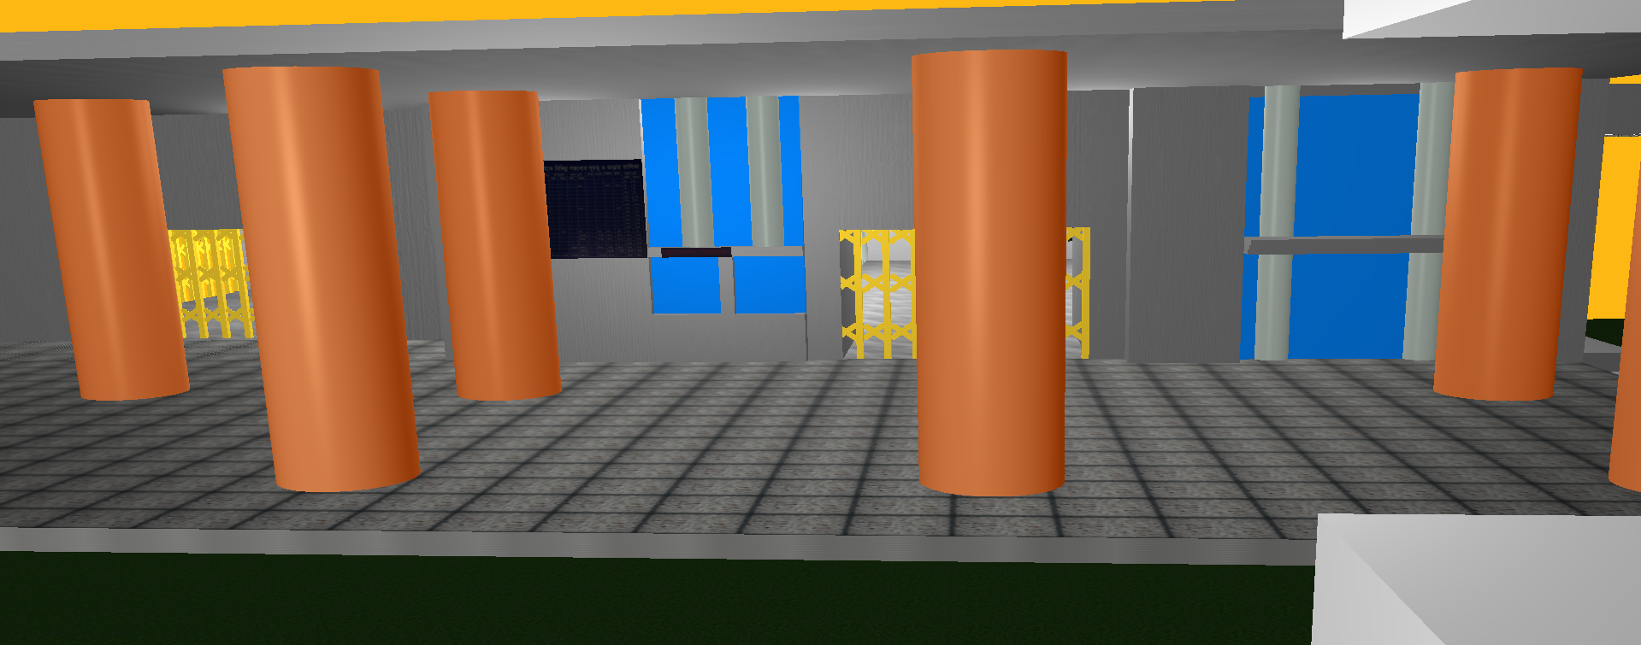
Detailed Visualization(contd.)

Slide 16
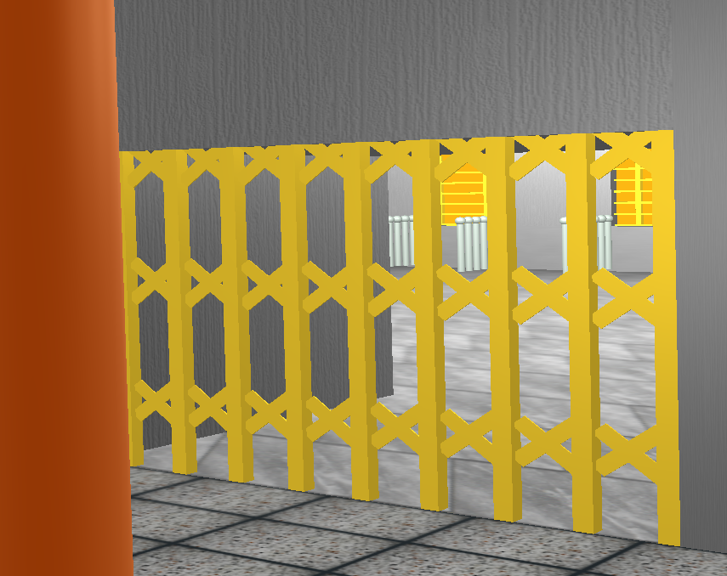
Detailed Visualization(contd.)

Slide 17
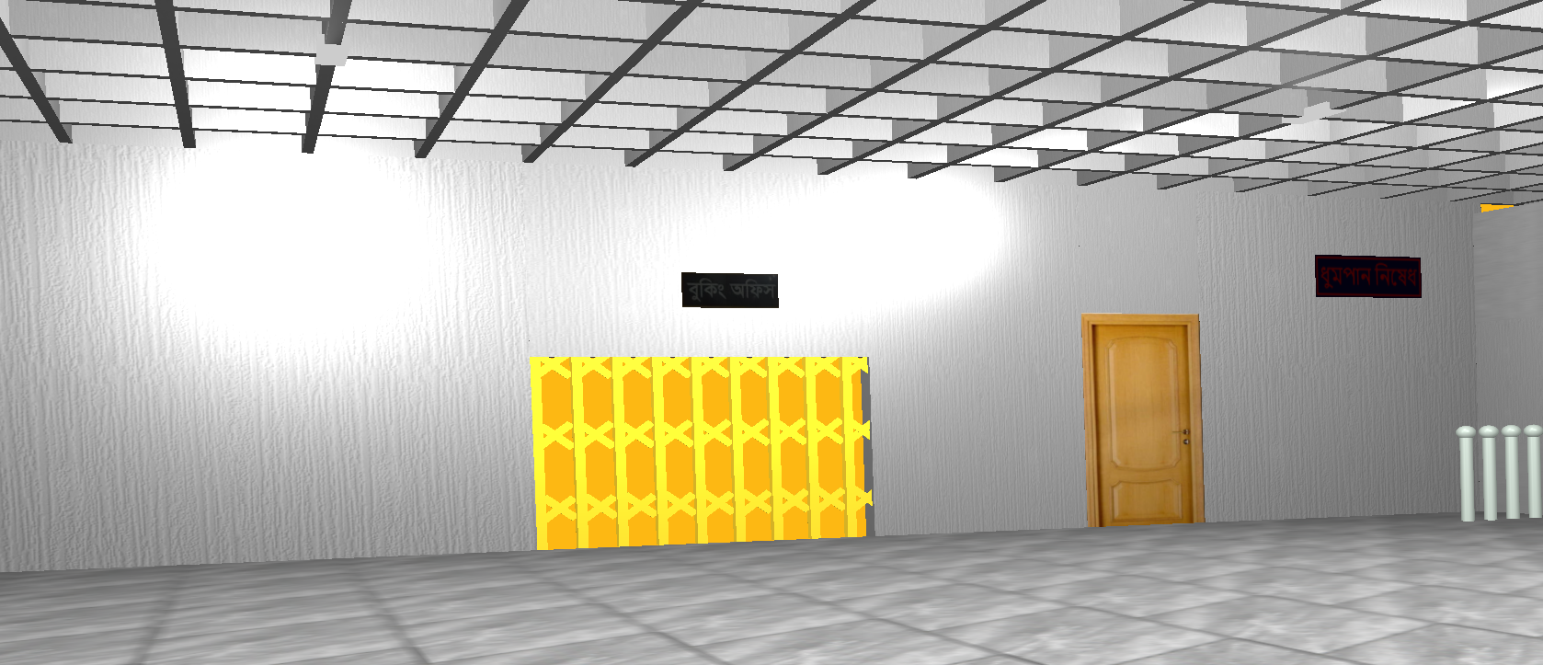
Detailed Visualization(contd.)

Slide 18
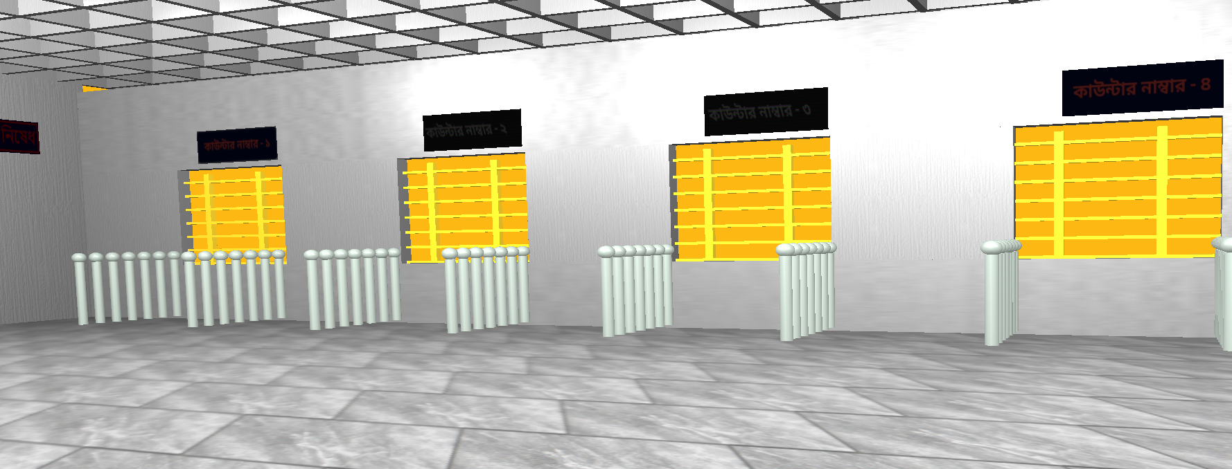
Detailed Visualization(contd.)

Slide 19
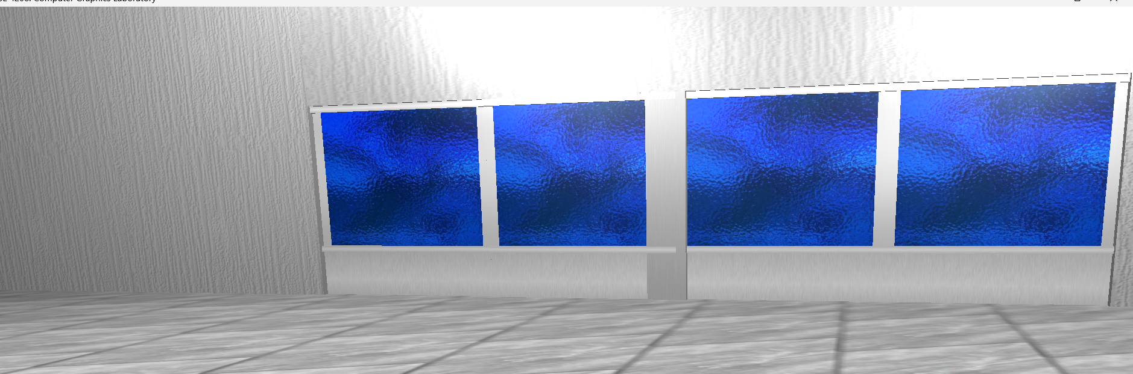
Detailed Visualization(contd.)

Slide 20
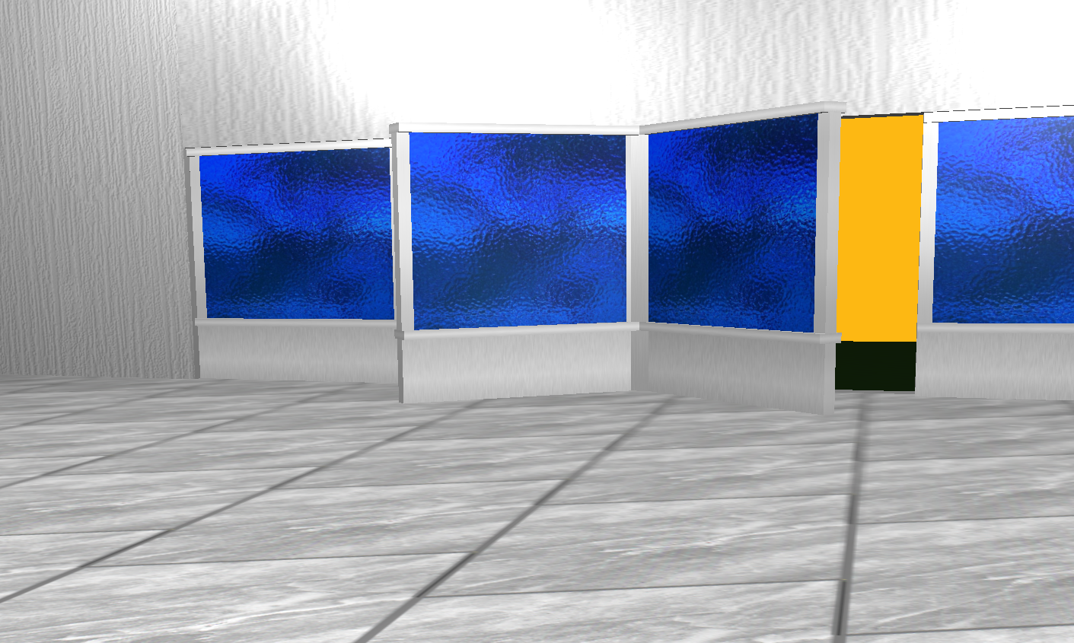
Detailed Visualization(contd.)

Slide 21
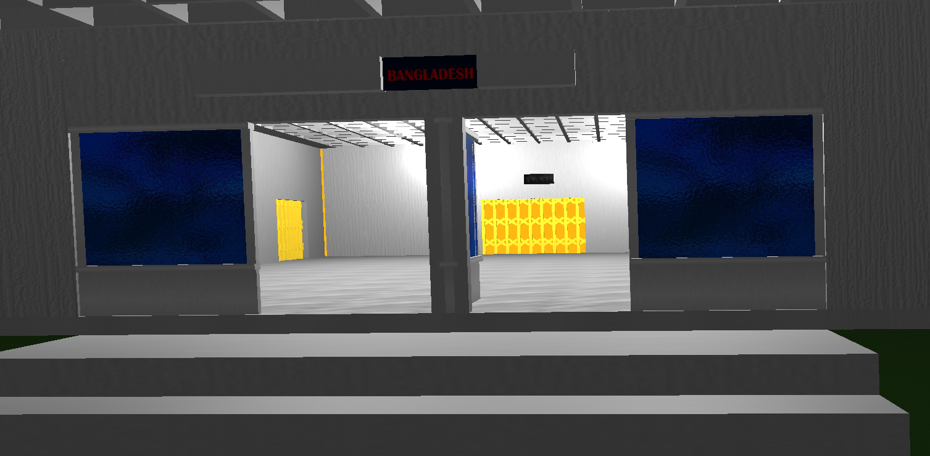
Detailed Visualization(contd.)

Slide 22
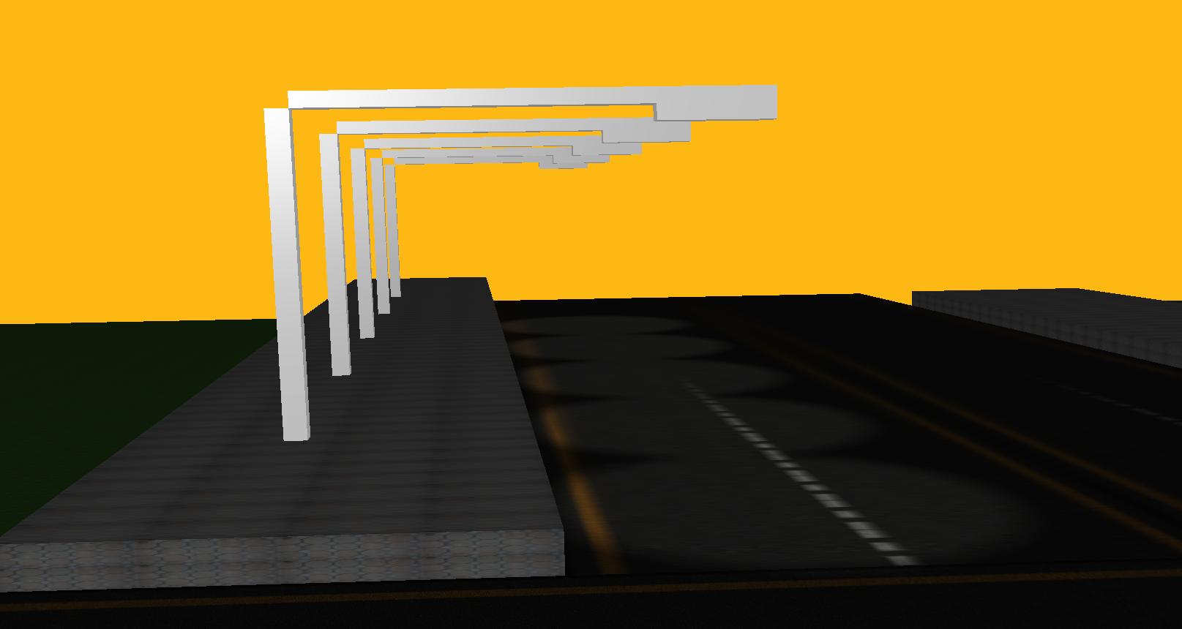
Detailed Visualization(contd.)

Slide 23
Outlines
04
CONCLUSION

Slide 24
Conclusion
What I Have Implemented:
Draw structure with cube
Draw structure with cylinder
Adding Texture
Implementing Roll, Pitch, YAW
Implementing Spot Light, Directional Light , Point Light

Slide 25
Thank You

Slide 26
Any Questions?

